Slide 1
DAC Meeting #1
September 12, 2019

Slide 2

Preamble:

Slide 3
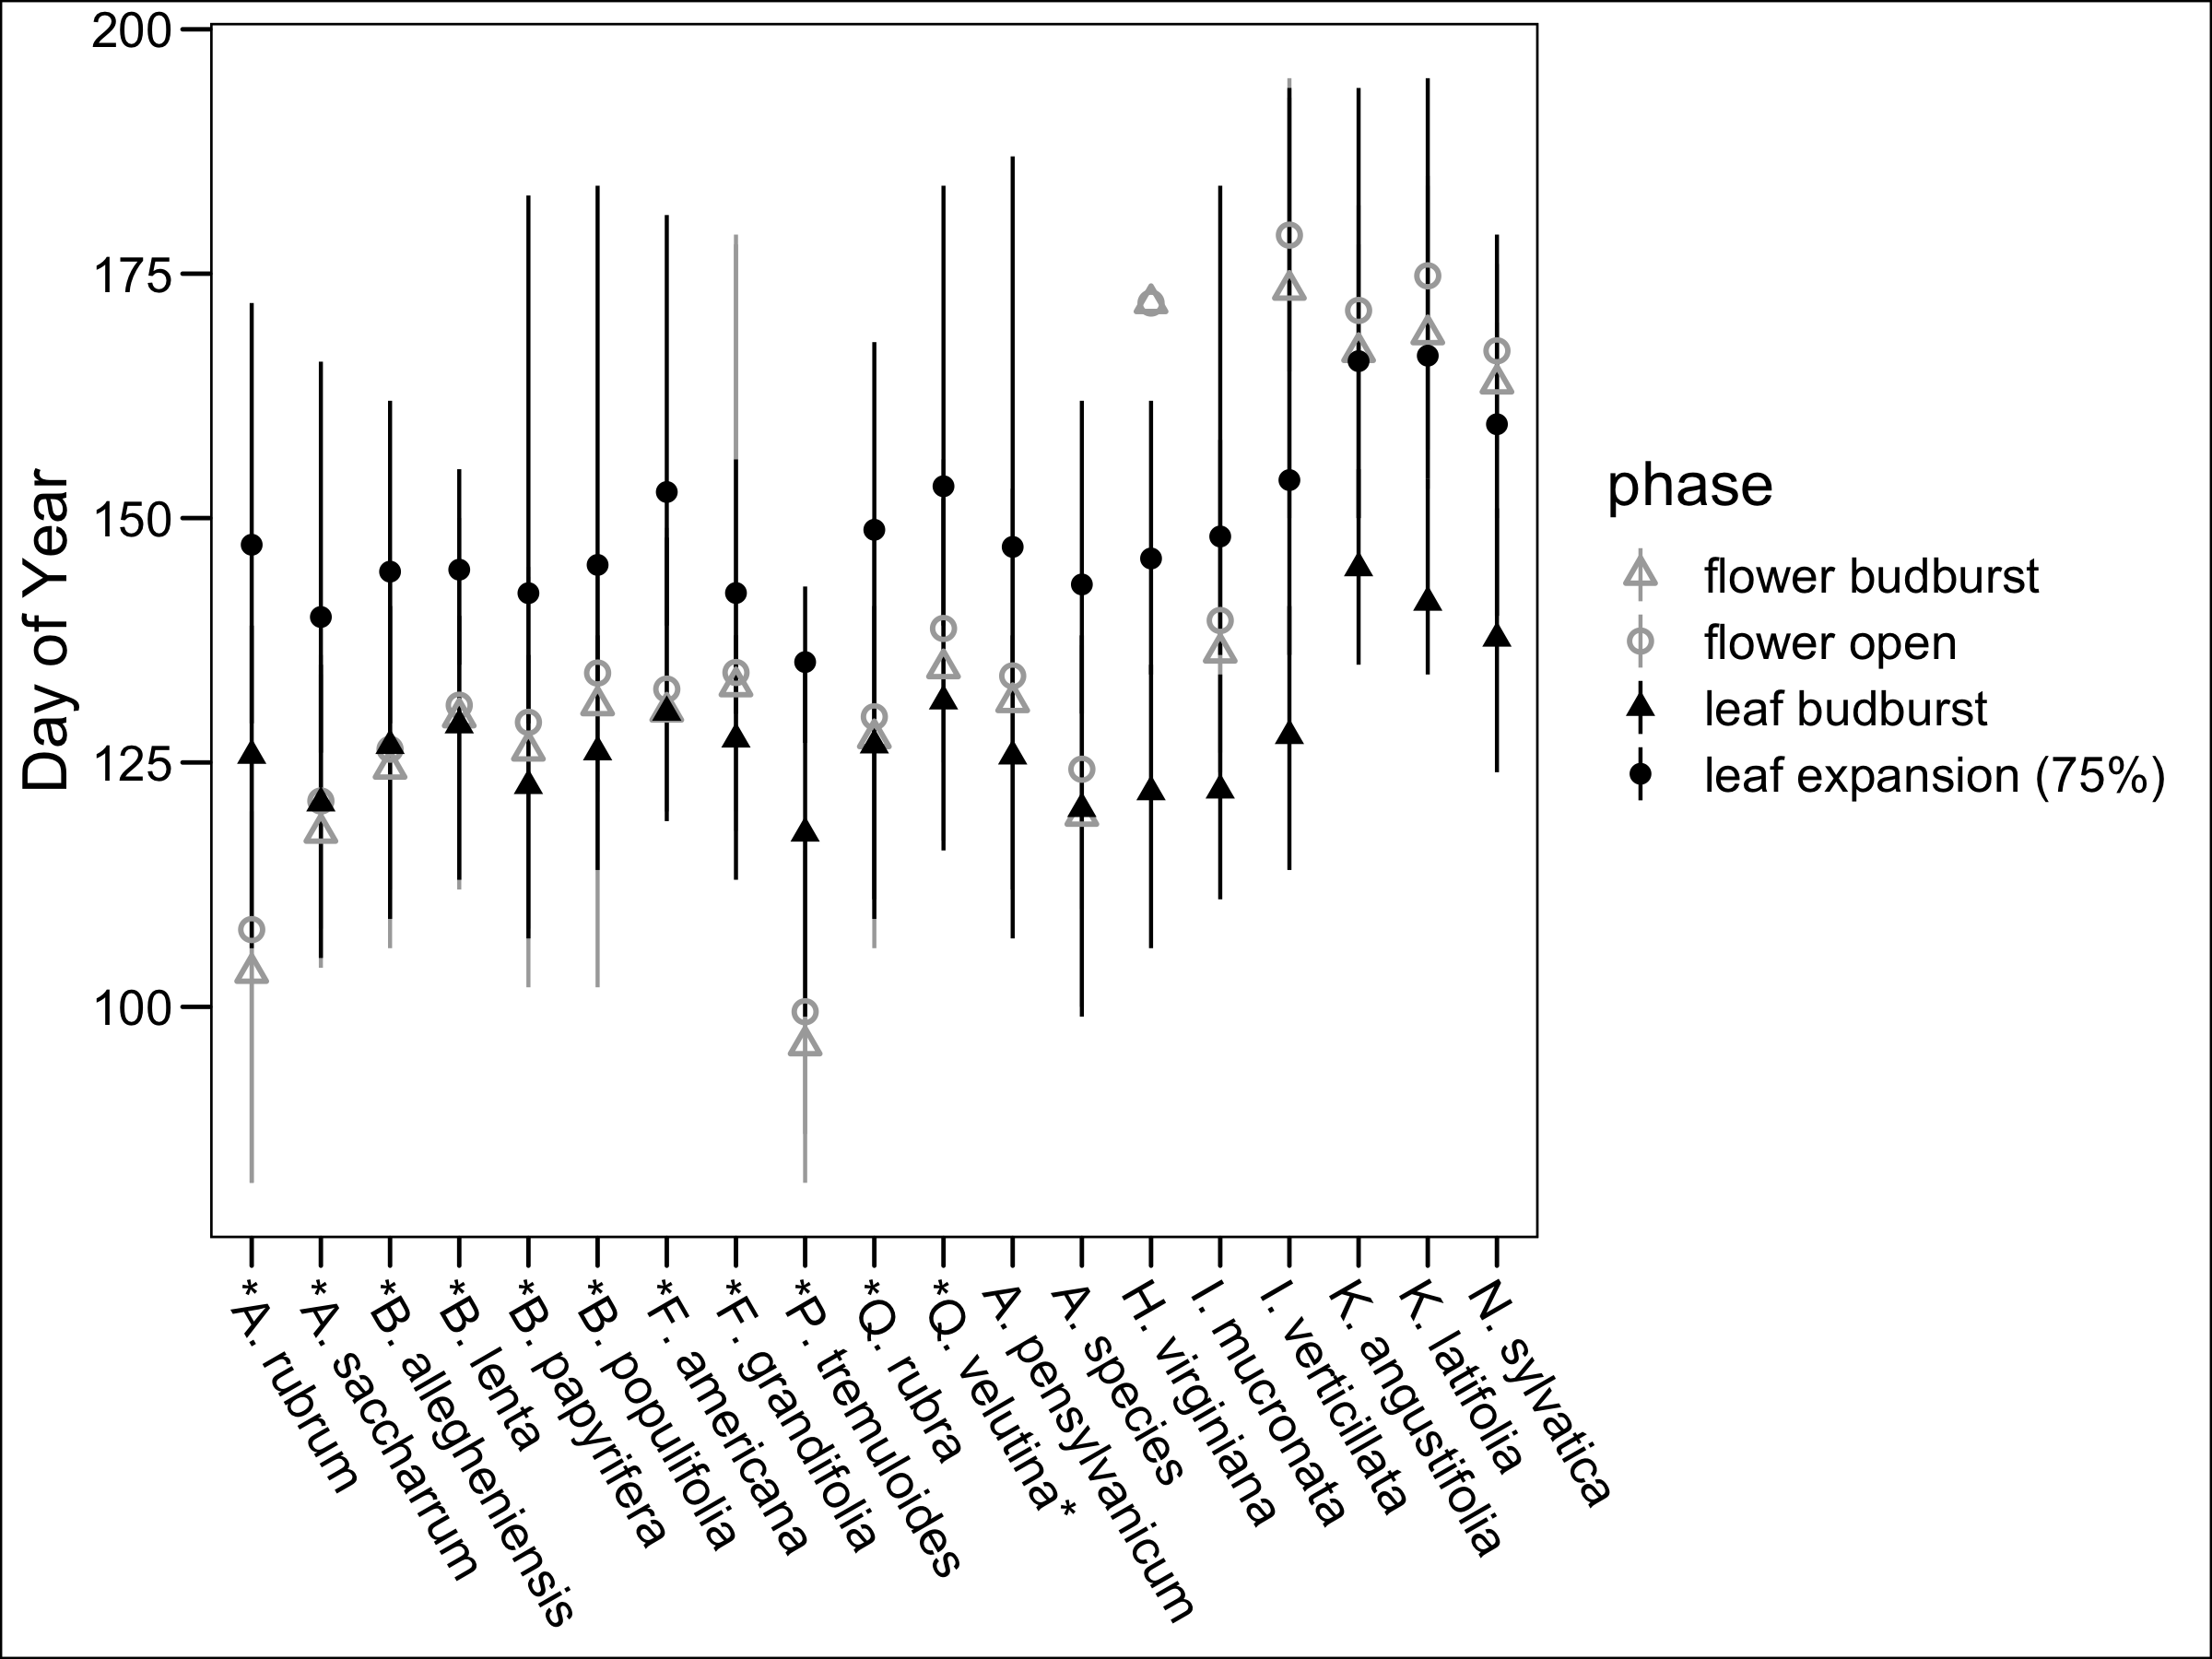
Chapter 1: Reconciling competing hypotheses regarding flower-leaf sequences in temperate forests for fundamental and global change biology
Why do some deciduous species flower before leafing?

Slide 4
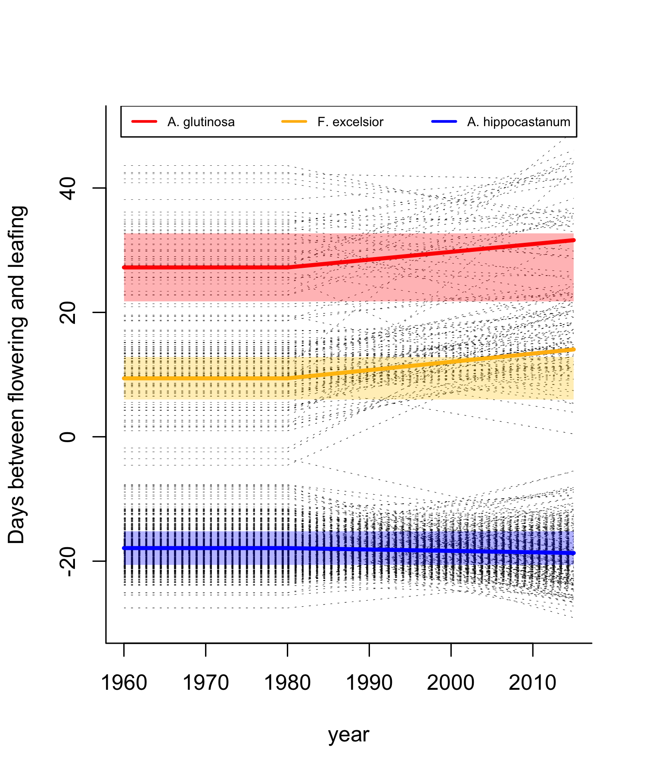
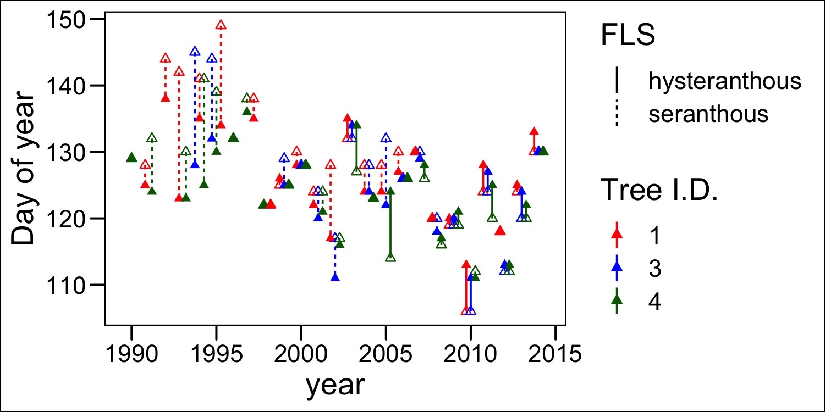
Chapter 1: Reconciling competing hypotheses regarding flower-leaf sequences in temperate forests for fundamental and global change biology

Slide 5
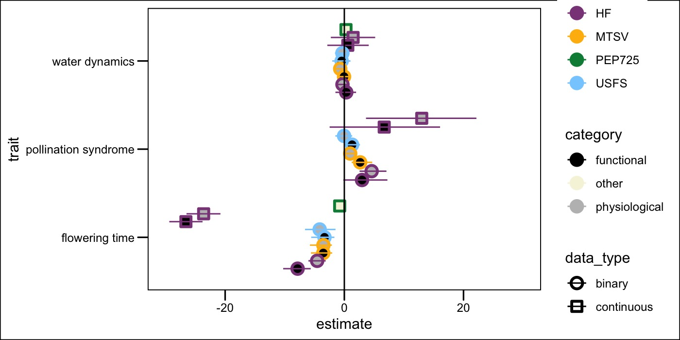
Chapter 1: Reconciling competing hypotheses regarding flower-leaf sequences in temperate forests for fundamental and global change biology

Slide 6
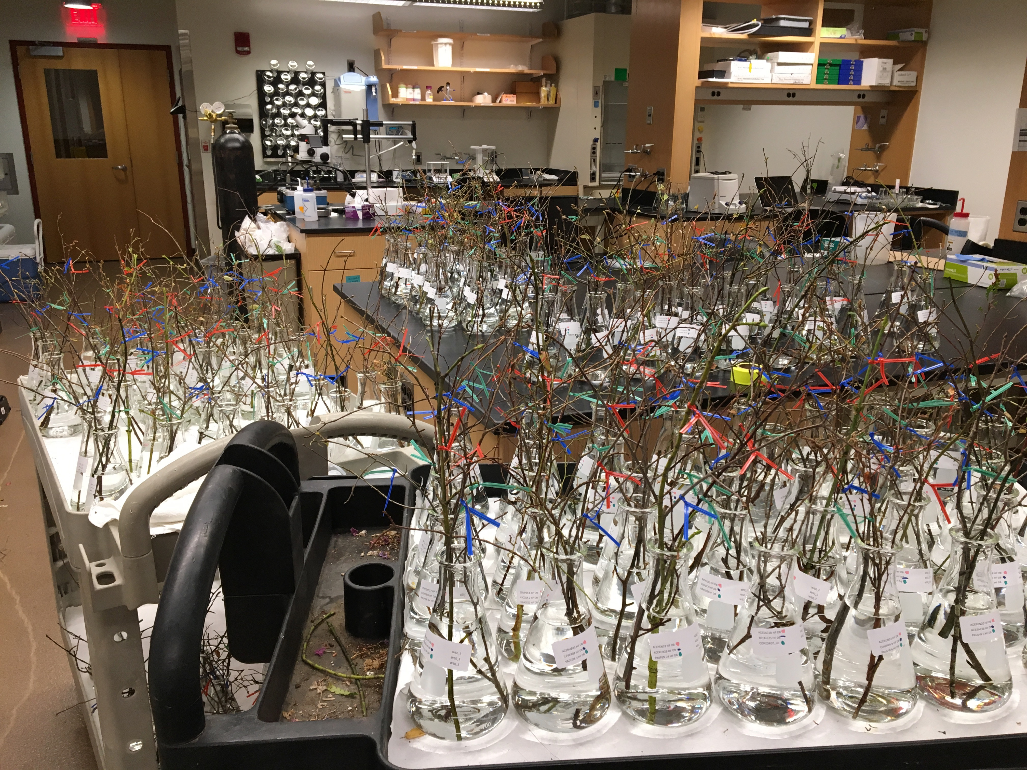
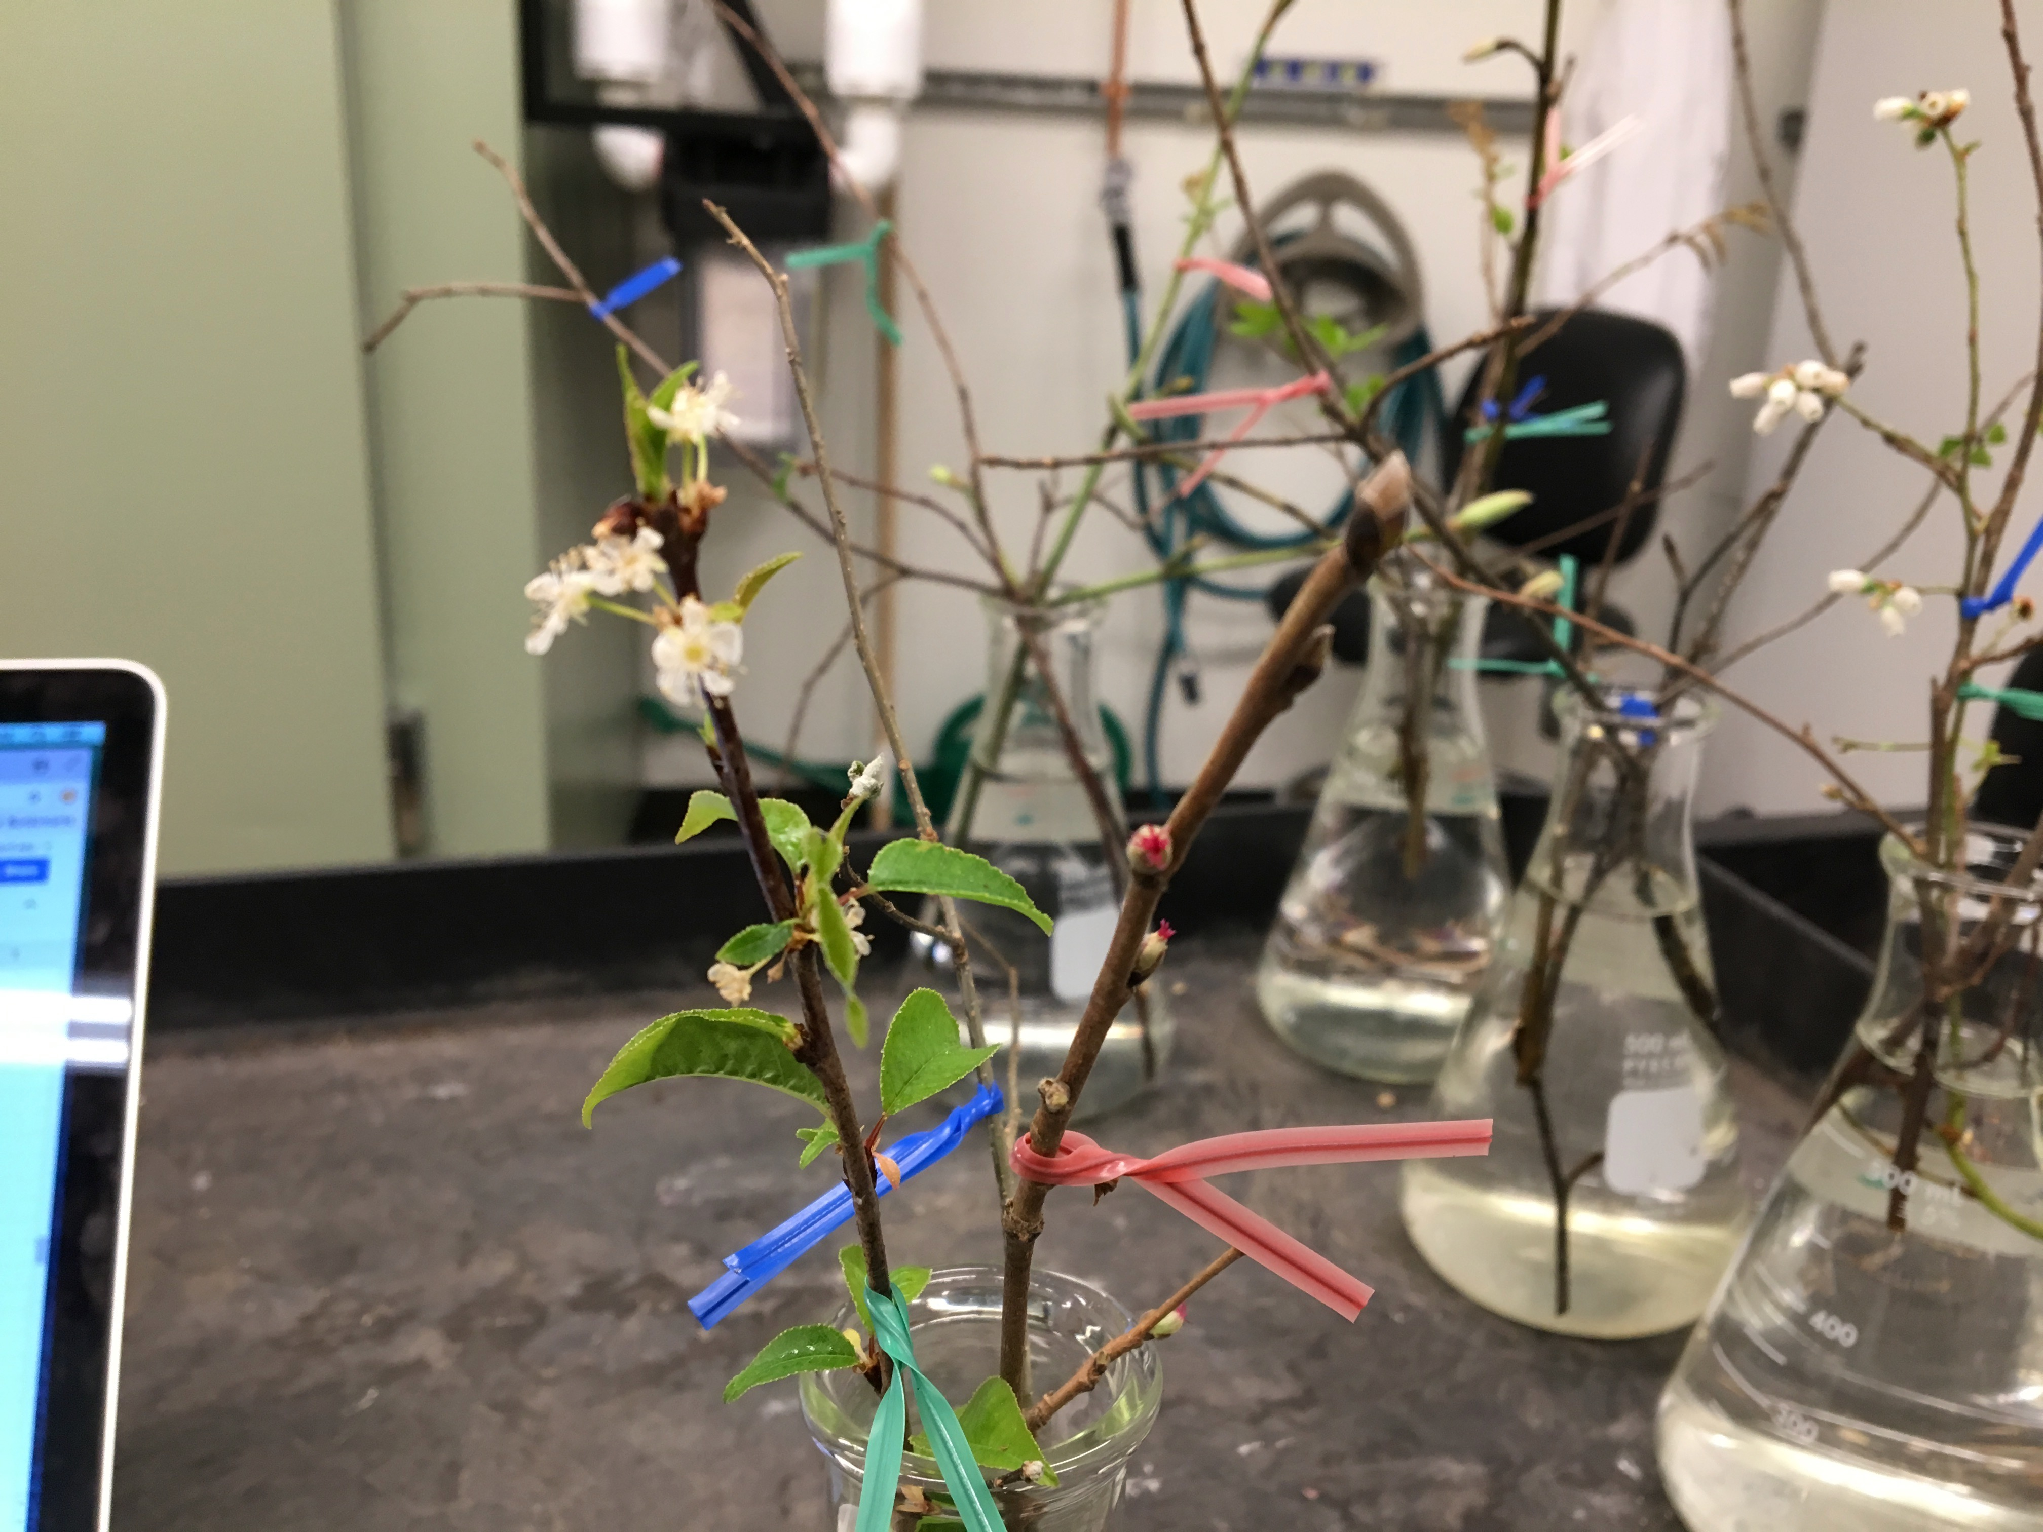
Chapter 2a: Differential sensitivity to environmental cues dictates variability in flower-leaf phenological sequences in temperate trees and shrubs

Slide 7
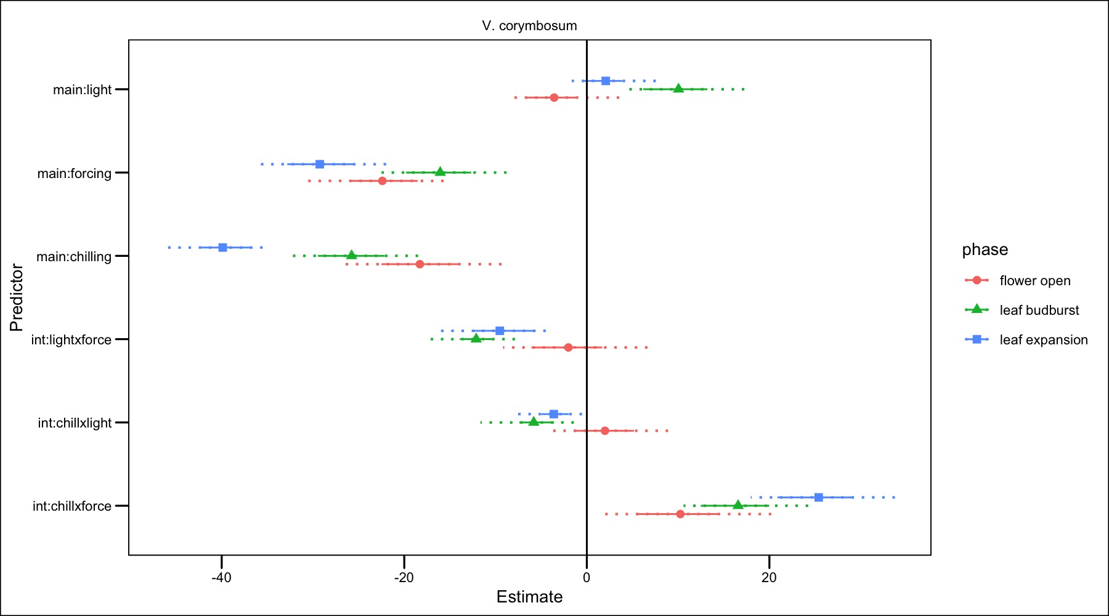
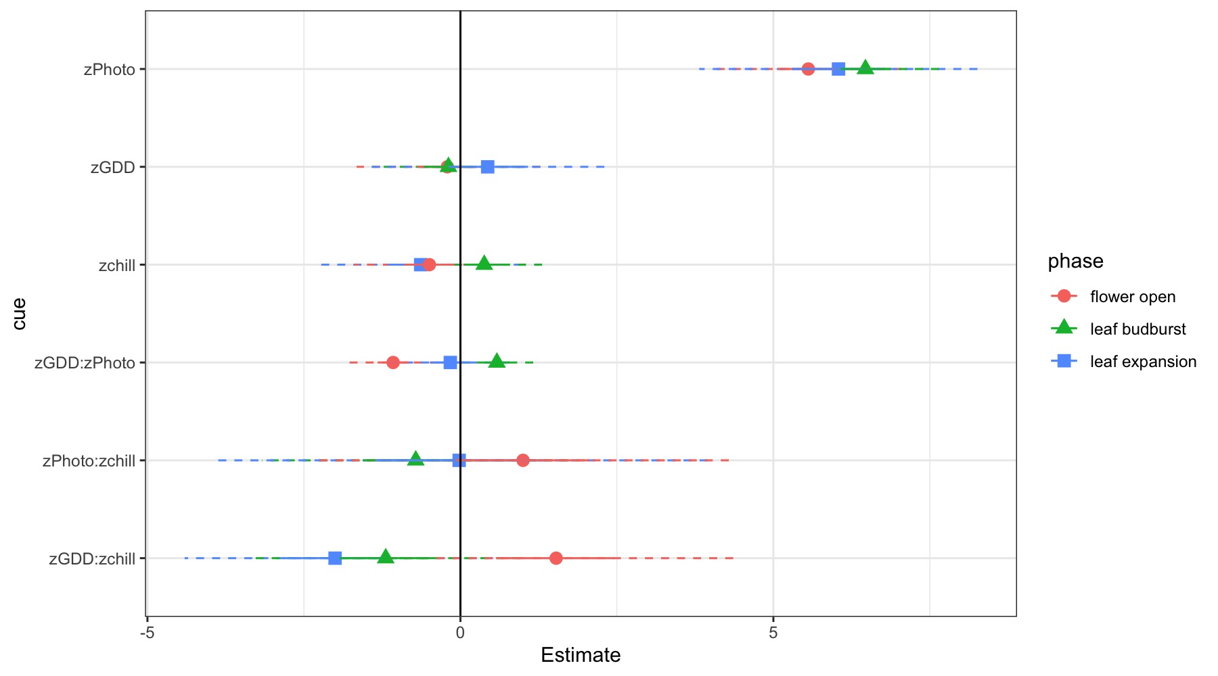
Chapter 2a: Differential sensitivity to environmental cues dictates variability in flower-leaf phenological sequences in temperate trees and shrubs
Notes:
How can I improve this comparision?
Chill Oct-1 halfway between fopn and leaf out
GDD Jan 1 and “”
Photo day length on each phase/2 ( average)
Problems: Super covaried in natures

Slide 8
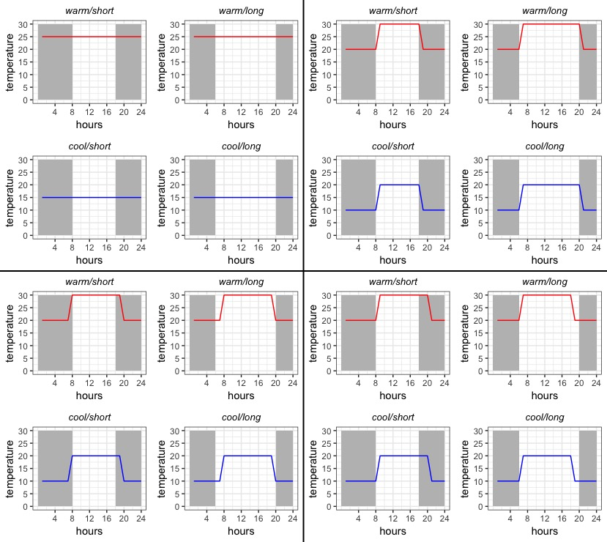
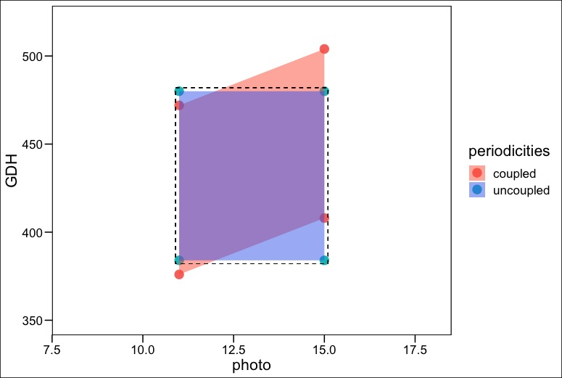
Chapter 2b: Untangling the effects of thermo- and photo- periodicity in controlled-environment experiments

Slide 9
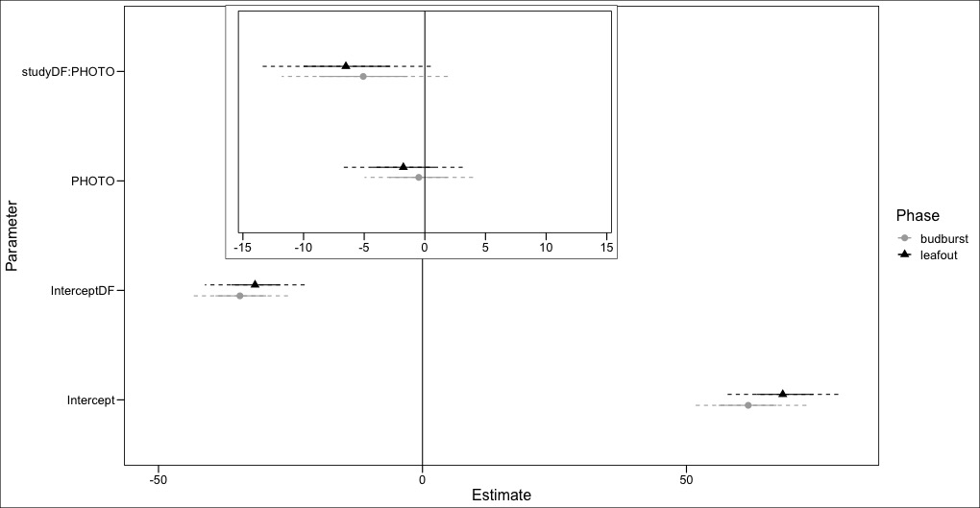
Chapter 2b: Untangling the effects of thermo- and photo- periodicity in controlled-environment experiments
Notes:
We predicted a difference of around 3. We observed differences -4.15 (2.55 Sd)
And 5.3 (3.O sd)
Data subset to Same forcing and similar chilling

Slide 10
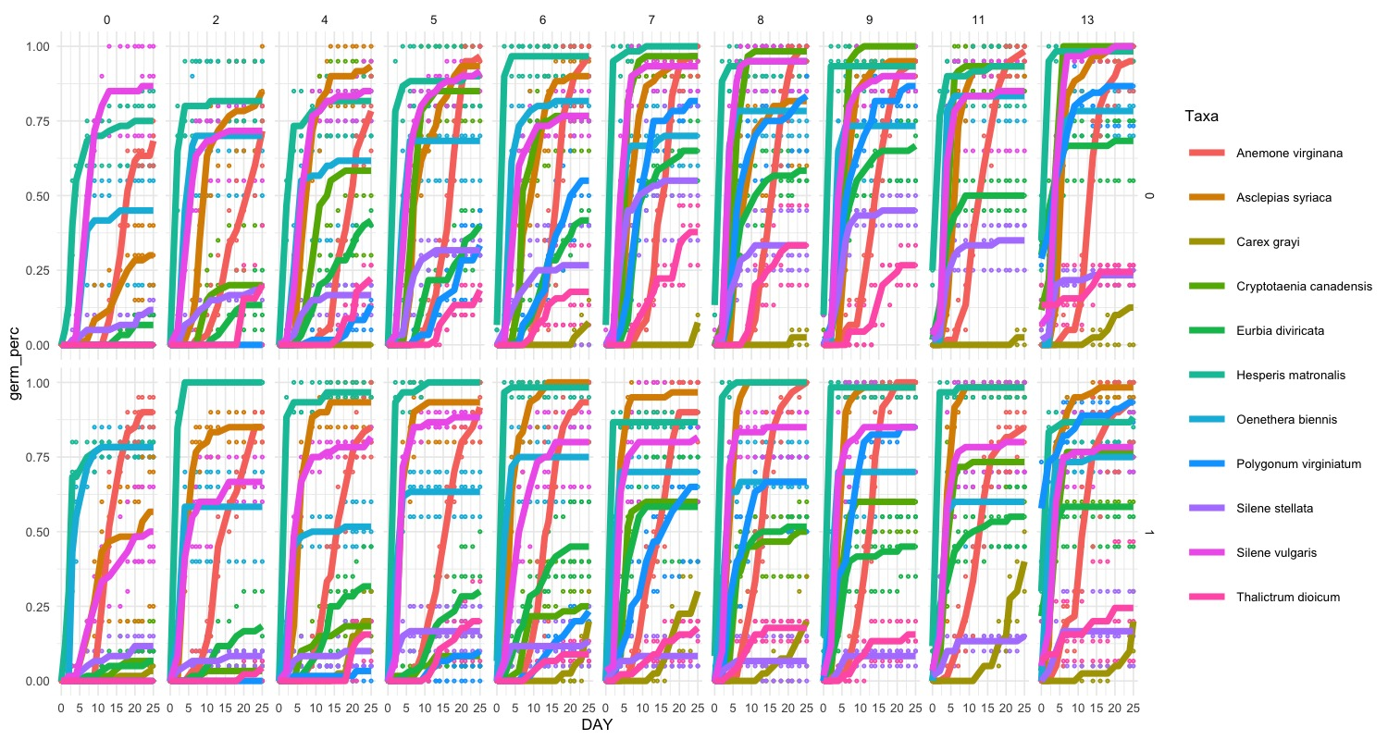
Chapter 3: Temperature variation alters germination rank of woodland herbaceous communities

Slide 11
Chapter 3: Temperature variation alters germination rank of woodland herbaceous communities
See model equation on board
Results:
For each species I’ll calculate:
Slope parameters for d, T50 and Beta response to Chill weeks*Inc T
Slope parameters for germination index response to Chill weeks*Inc T
Questions:
What is the story?
Is the assumption that each parameter sub-model is linear?
How can I test for thresholds vs continuous response?
Notes:
Can I actually comment on storage effect with out seeing reproduction.

Slide 12
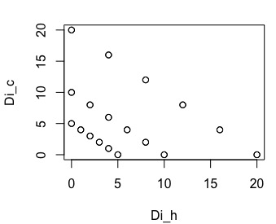
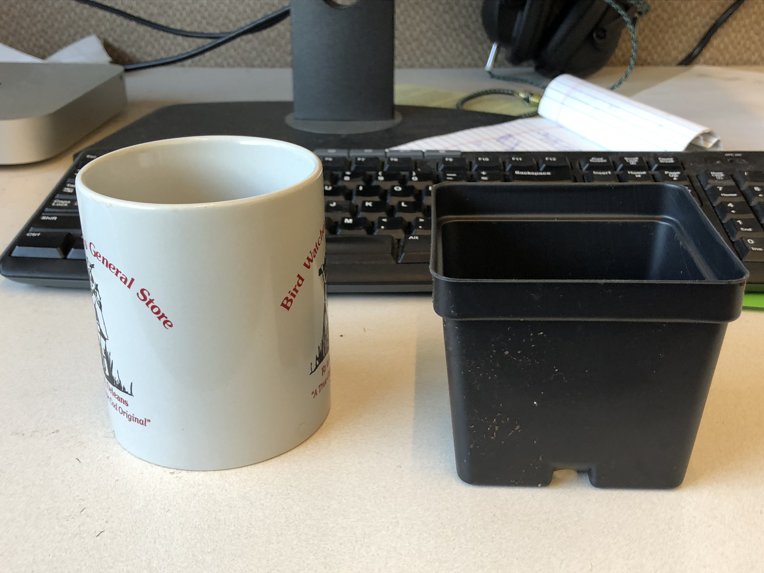
Chapter 4: Seasonal priority effects (might) alter inter-specific competition among herbaceous plants
How big to make the response surface?
How many replicates?
limited by chamber space ~49-50
3.5 in square pots
Notes:
Major question 1: How to handle starting conditions. Number of seeds vs number or germinates. Seed masses (if seeds are different sizes)
How to track germinants, tooth pick tricks?

Slide 13
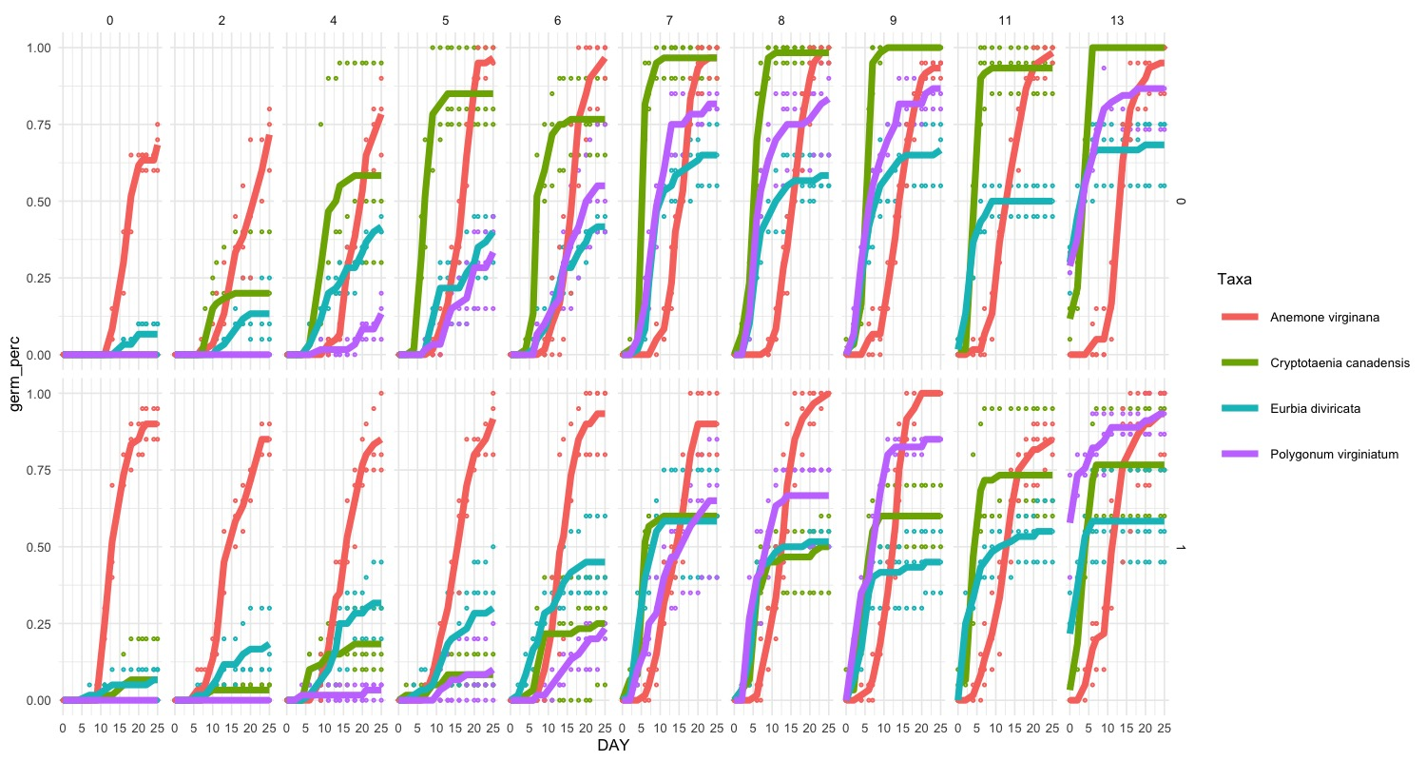
Chapter 4: Seasonal priority effects (might) alter inter-specific competition among herbaceous plants
Which species?
Notes:
Cryptotania and Polygonum @ 8 weeks
How to address that the differences seem mainly to do with final grown percentage than
Also invasive that always completes germinates in 2-3 days
Draw what I was hoping for

Slide 14
Chapter 4: Seasonal priority effects (might) alter inter-specific competition among herbaceous plants
Next steps
Try candidate species in soil and inter-specific mixes:
3 replicates of:
20:0, 10:10: ,0:20
10:0, 5:5, 0:10
For each condition
Select 2-3 species and 2 conditions for competition experiment
Set up full response surface
20 days of germination conditions (or less depending on species)
Transfer to all treatments to greenhouse to contain temperature effects to germination
Measure: Height and leaf count every 2 weeks?
Measure final harvest biomass after 3 or 4 months?

Slide 15
Time line
Fall 2019: 1. Submit chapter 1 2. Complete draft of chapter 2a 3. Fix ideal chapter 3 model on simulations
4. Begin experiment for chapter 4
Spring-Summer 2020: 1. Submit paper for chapter 2a 2. Complete and submit paper for chapter 2b
3. Chapter 3 analysis on real data 4. Continue chapter 4 experiment
5. Teach: OEB 55
Fall 2020:
Continue chapter 3 analysis
2. Begin Chapter 4 analysis 3. Teach ?*
Spring-Summer 2021: 1. Continue chapter 3 analysis
2. Begin chapter 4 analysis 3. Teach OEB 55 or OEB 52
Fall 2021: 1. Complete chapter 3 analysis and write paper. 2. Continue chapter 4 analysis. 3. Teach?
Spring 2022: 1. Complete chapter 4
2. Defend dissertation
Notes:
*Ideally woody plants with chuck but open to other ideas

